Slide 1
Active Learning
Learning Active Learning from Real and Synthetic Data
-Yunong He

Slide 2
Key idea:
A novel data-driven approach to active learning: Learning Active Learning (LAL).
Train a regressor that predicts the expected error reduction for a potential sample in a particular learning state.
By treating the query selection procedure as a regression problem we are not restricted to dealing with existing AL heuristics
Learn strategies based on experience from previous active learning experiments.
Automatically comes up with task-appropriate query selection strategies

Slide 3


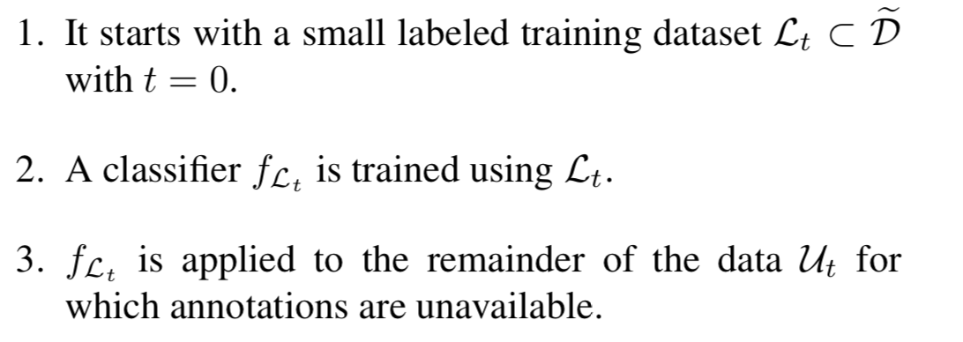
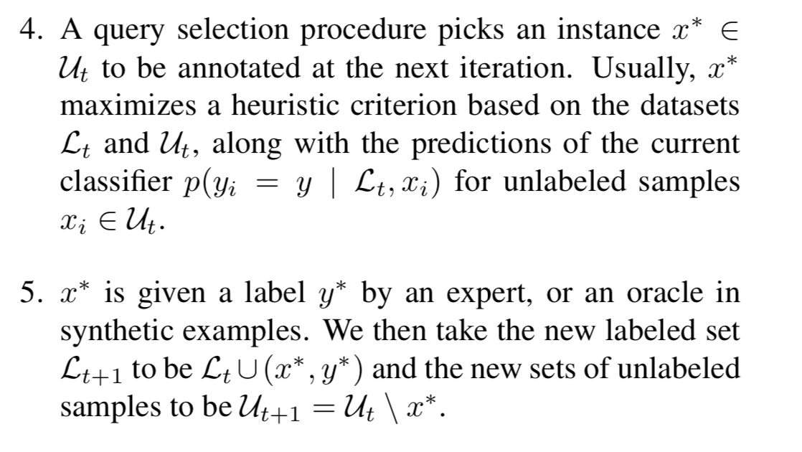
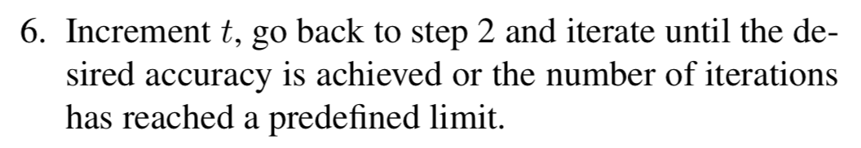
The standard AL procedure:
Target dataset:
x_{i} is a d-dimensional feature representation of a datapoint and y_{i} ∈ {0, 1} is its binary label
choose a classifier f that can be trained on some Lt ⊂ D to map features to labels

Slide 4
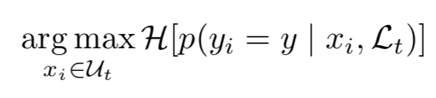
Motivation：
Uncertainty Sampling:
selecting first samples about which the current classifier is least certain.
There are many definitions of maximum uncertainty but one of the most widely accepted is to select samples that maximize the entropy H over predicted classes.
In other words, this means taking x∗ to be
Notes:
Given a trained classifier and its output for a spe- cific sample with unknown label, we predict the reduction in generalization error that can be expected by adding the label to that point.

Slide 5


Approach: formulate LAL as a regression problem
Split the dataset into training D and testing D′ data and use a small subset of labels from D to train an initial classifier, which performance is tested on D′.
A number of parameters φ that characterizes the state of the classifier is evaluated.
Incorporate unused labels from D individually to retrain the classifier.
Start the LAL Monte-Carlo procedure by splitting D into a labeled set L_{τ} of size τ and an unlabeled set U_{τ} containing the remaining points.
The loss of f_{L0} on D′ is
Where
Only consider simple 0/1 loss

Slide 6
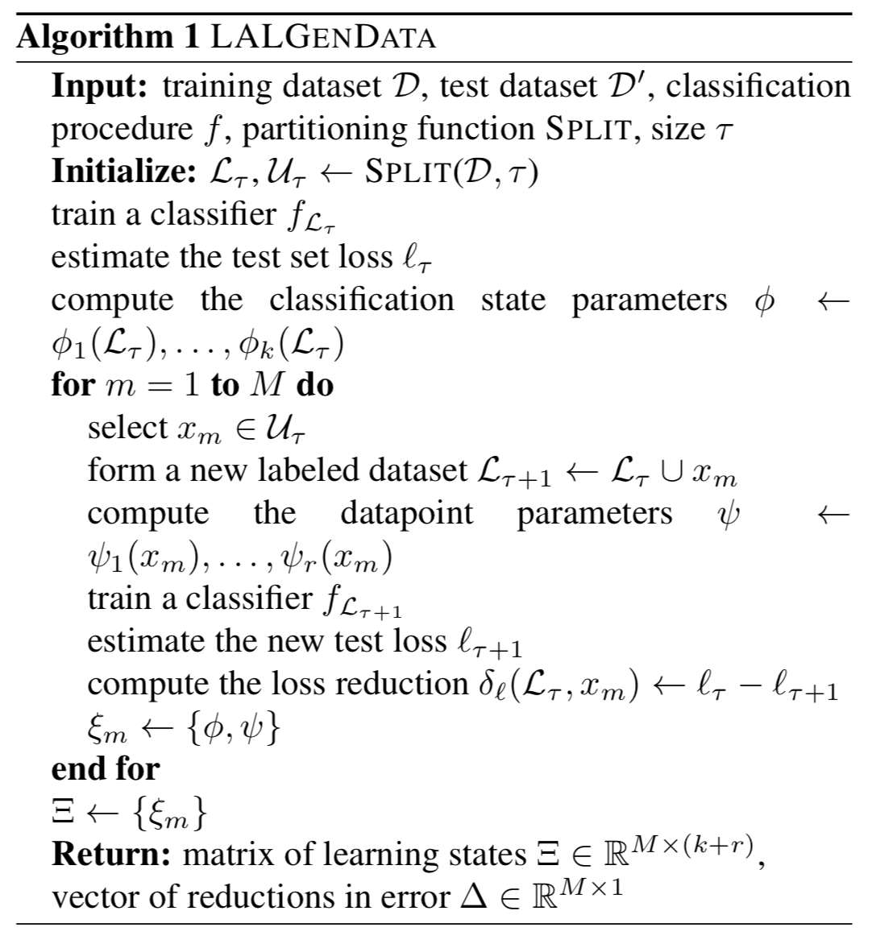
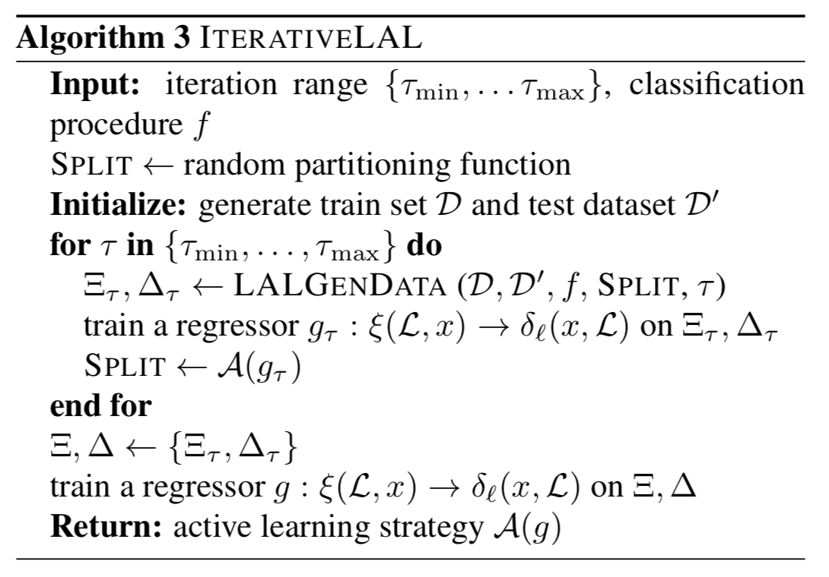
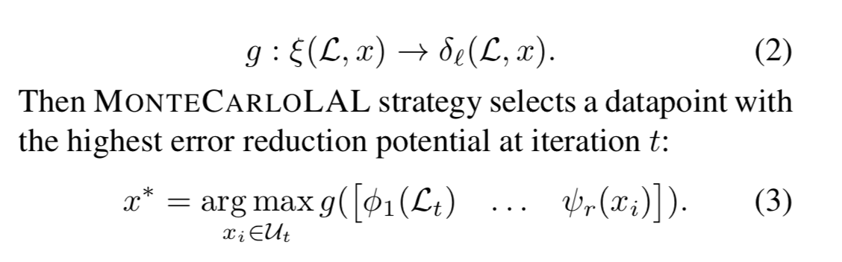
Algorithm:
Notes:
We learn a different AL strategy Aτ at every iteration τ . Aτ tells us which datapoint should be selected at iteration t = τ − 2 of AL.
In this way, samples at iteration τ + 1 depend on the samples at iteration τ and the sampling bias of AL is well represented in data Ξ, ∆ from which the final strategy is leant

Slide 7
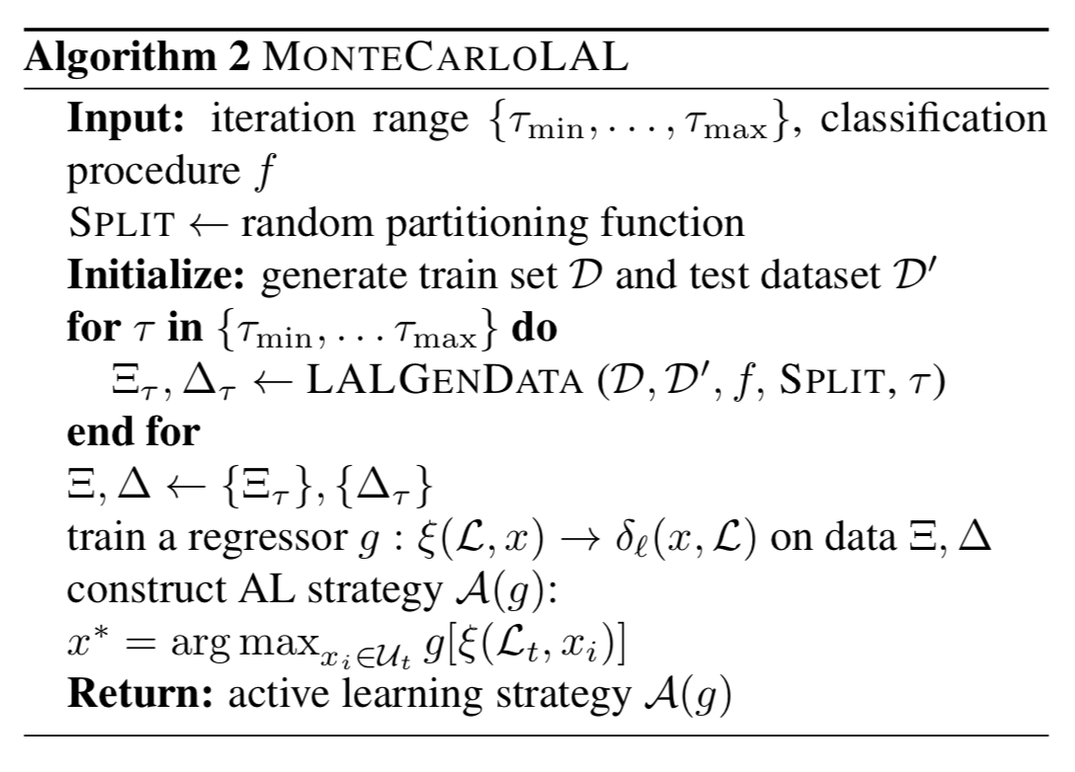
Algorithm:

Slide 8

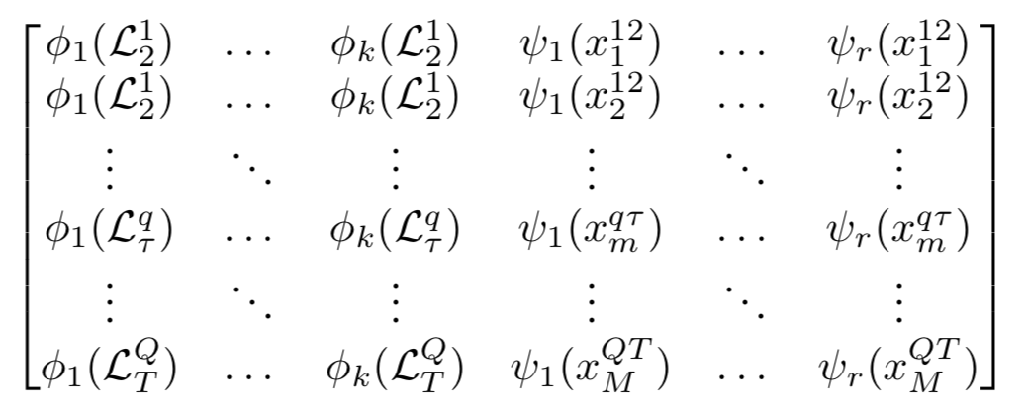
Explanation:
Characterize the classifier state by recording k parameters φ1 (Lτ ), . . . , φk (Lτ ), which are specific to particular classifier families and change as the training progresses.
For example, they can be the parameters of the kernel function if f is kernel-based, average depths of the trees if f is a random forest, or prediction variability if f is an ensemble classifier
Characterize the effect of a datapoint on the state of learning by instantiating r parameters ψ1 (x), . . . , ψr (x).
For example, they can include the predicted probability of class y, the distance to the closest point in the dataset or the distance to the closest labeled point.
The matrix :

Slide 9
Examples:
Choice of classifier and regressor:
Random Forest and Gaussian Process classifiers for f
Random Forest and Gaussian Process regressors for g
Classifier features:
The vector ξ that characterize the state of the learning process can be composed of the following features:
a) predicted probability: p(yi = 0|Dt , xi )
b) proportion of class 0 in Dt
c) out-of-bag cross-validated accuracy of f_{Dt}
d) variance of feature importance of f_{Dt}
e) forest variance computed as variance of trees’ predictions on U_{t}
f) average tree depth of the forest
g) size of Lt.

Slide 10
Experiment:
Compare the performance of LAL against several baselines both on synthetic and real data
Compare the following three versions of our approach:
LAL-MC-2D: Algorithm1+Algorithm2
LAL-iterative-2D: Algorithm1+Algorithm3
Against the following baselines:
Rs: random sampling.
Us: uncertainty sampling.
Kapoor: approach of Kapoor et al. (2007) that balances exploration against exploitation by incorporating mean and variance estimation of the GP classifier.

Slide 11
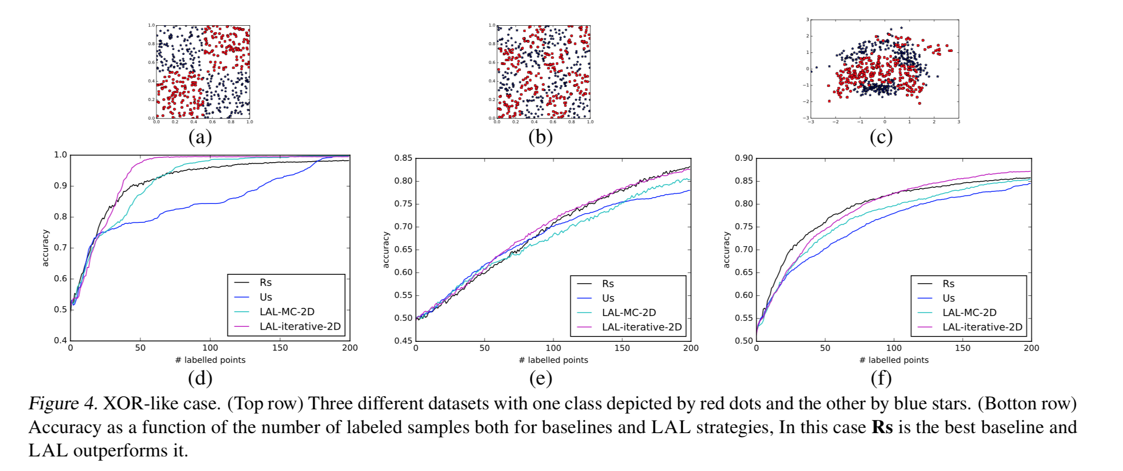

Slide 12
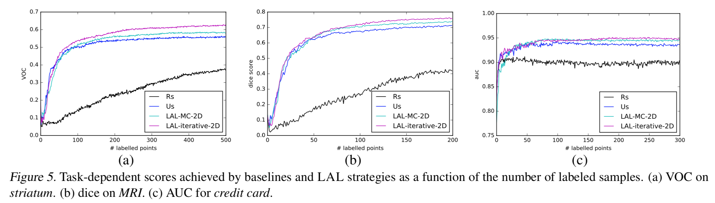

Slide 13
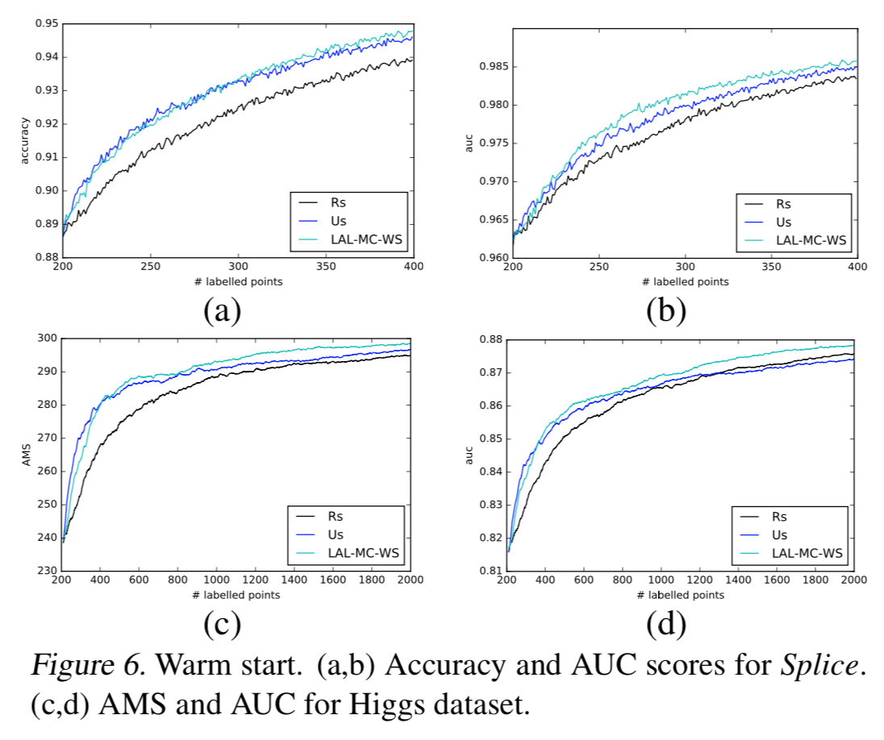

Slide 14
Thanks!
Reference:
https://pdfs.semanticscholar.org/fed6/a1491c61eaeb0d284fdb52a66d23d383c7b7.pdf
https://github.com/ksenia-konyushkova/LAL

